Slide 1
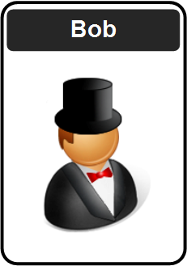
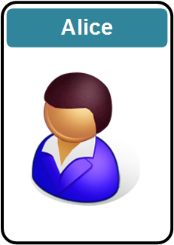


Future of Digital Trust
Prof Bill Buchanan OBE FRSE
https://asecuritysite.com
Zero Knowledge Proofs Fiat Shamir, DLEQ, zkSnarks,
Ring Signatures, Range Proofs, Accumulators, Pedersen Commitments
Homomorphic Encryption:
Basics
Concepts and Code Data Sharing Cloud Processing MPC Machine Learning

Slide 2
Deep Tech Workshops
Workshop 1 (Wednesday, 26 March 2025, 10am CET). Cryptography Fundamentals here.
Workshop 2 (Wednesday, 16 April 2025, 10am CET). Blockchain and Cryptocurrency here.
Workshop 3 (Wednesday, 7 May 2025, 10am CET). Cyber, AI and Post Quantum here.
Workshop 4 (Wednesday, 4 June 2025, 10am CET). Homomorphic Encryption and Zero Knowledge Proofs here.
Moodle Page: here and GitHub: here.

Slide 3
Workshop 4
10-11am (CET) Zero Knowledge Proofs and Fully Homomorphic Encryption
The topic covered is Zero Knowledge Proofs and Fully Homomorphic Encryption. The presentation on ZKPs and Fully Homomorphic Encryption is here.
11-12pm (CET) Guest speakers
Kazım Rıfat Özyılmaz - Co-founder of Arf here (Bill).
Ibrahim Kushchu CEO, TheNextMinds UK here (Gonca).
Aditya Shetty - Lead of Superteam India here (Aysegul).
12-1pm (CET) Break.
1-2pm (CET) ZKP/FHE Demos and Quiz
This will provide some demos and a quiz.
2-3pm (CET) Guest speaker
Madjid Golparvaran Tehrani. PQC and Quantum Computing.
3-4pm (CET) World-leaders in Cryptography: Chris Peikert, University of Michigan.

Slide 4
Cryptography Overview
Prof Bill Buchanan OBE FRSE
https://asecuritysite.com

Slide 5
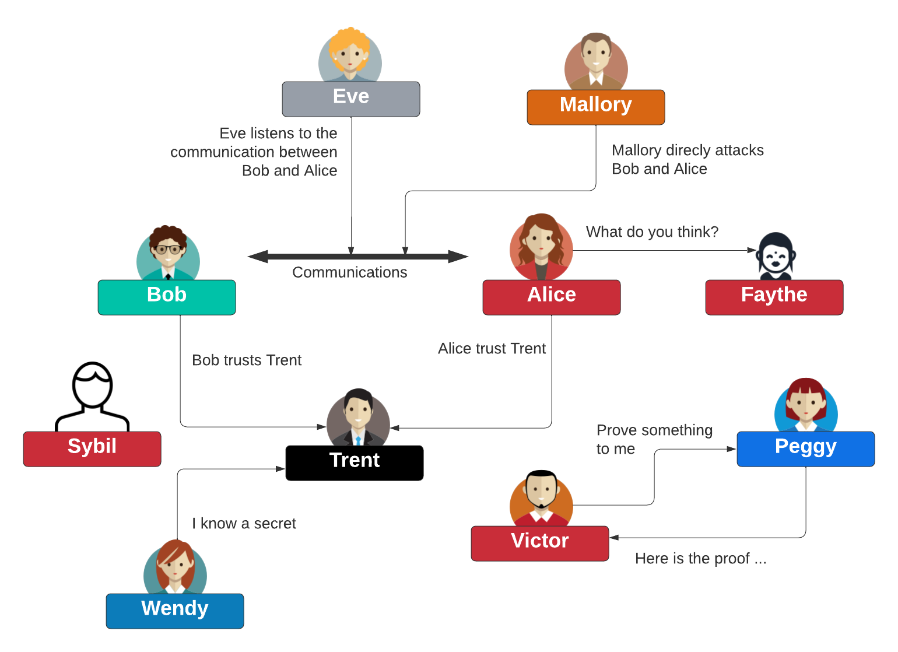
Some Actors

Slide 6
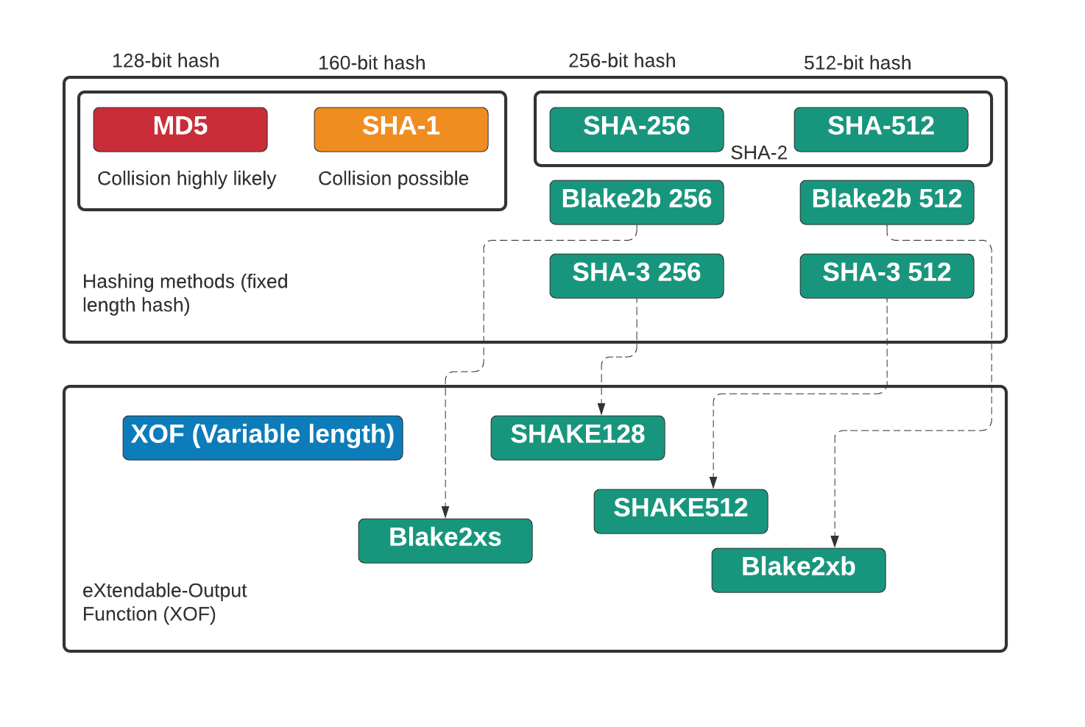
MD5, SHA-1, SHA-2, SHA-3 and XOF
https://asecuritysite.com/hash/cs

Slide 7
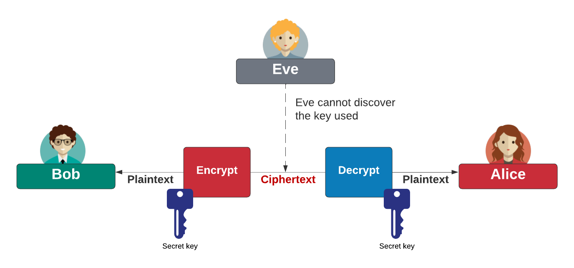
Symmetric Key
Block cipher: AES (128-bit block), DES (64-bit block), 3DES (64-bit block), Blowfish, SM4, Camellia, GOST, IDEA, RC2, Serpent, Skipjack, Twofish, and XTEA Stream cipher: ChaCha20, AES GCM, ARIA, Sala20, and RC4. AES also known as Rijndael (after Joan Daemen and Vincent Rijmen). ChaCha20 created by Daniel J Bernstein. Blowfish and Twofish created by Bruce Schneier.

Slide 8
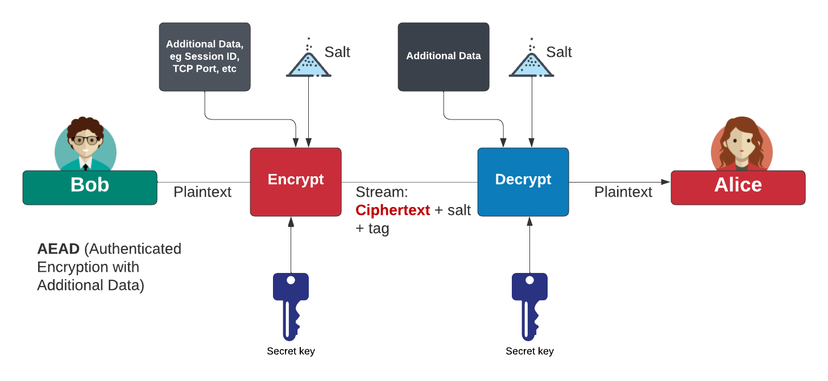
Authenticated Encryption with Additional Data (AEAD)
AES Block cipher modes: ECB (No salt), CBC (Cipher Block Chaining).
AES Stream modes: CFB (Cipher Feedback), OFB (Output Feedback), CTR (Counter), GCM (Galois Counter Mode).
https://asecuritysite.com/golang/go_symmetric

Slide 9
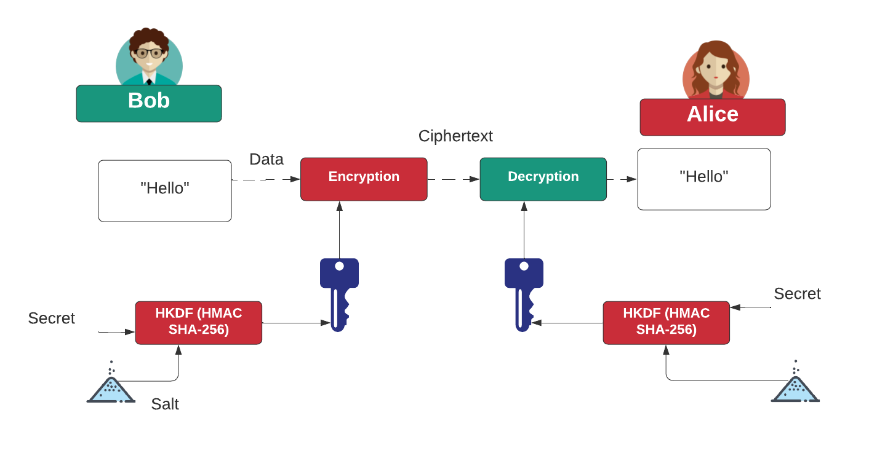
HKDF (HMAC Key Derivation Function)
https://asecuritysite.com/pbkdf2/hashnew3

Slide 10
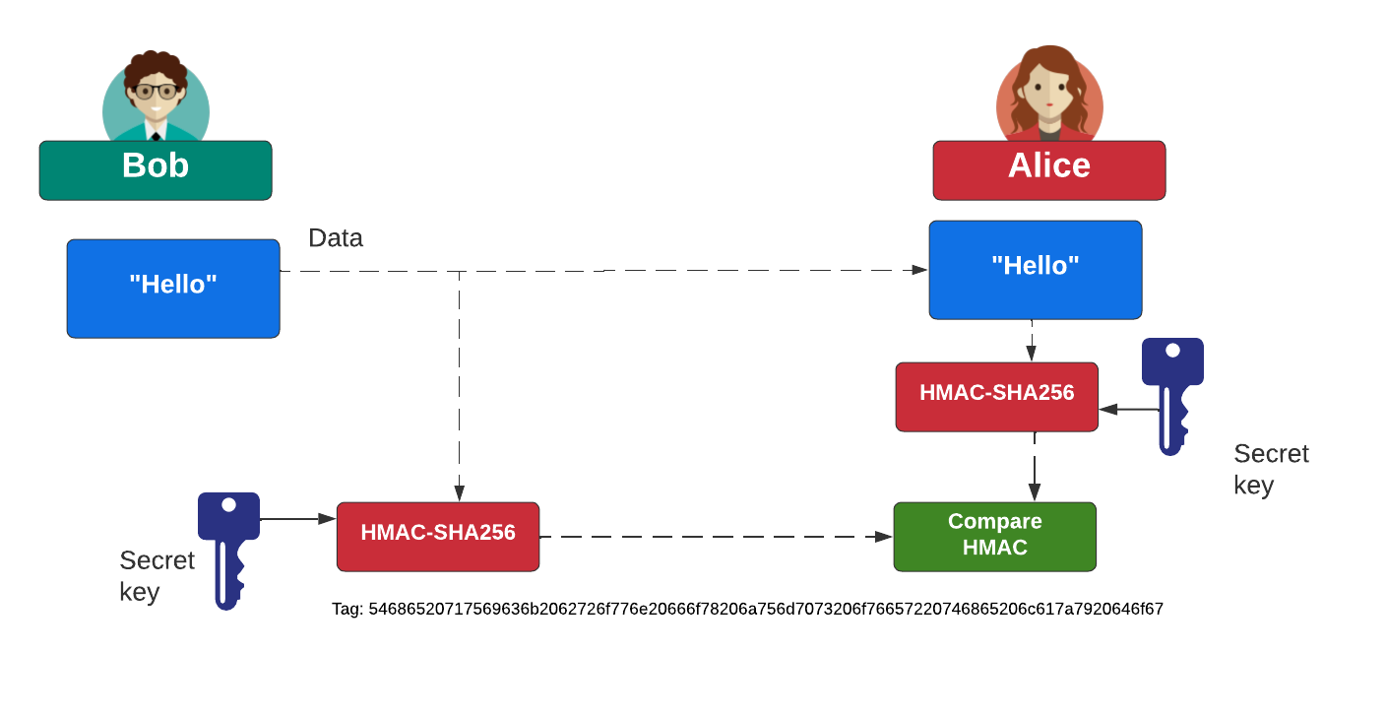
HMAC (Key Hash Message Authentication Code)
https://asecuritysite.com/mac/hashnew2

Slide 11
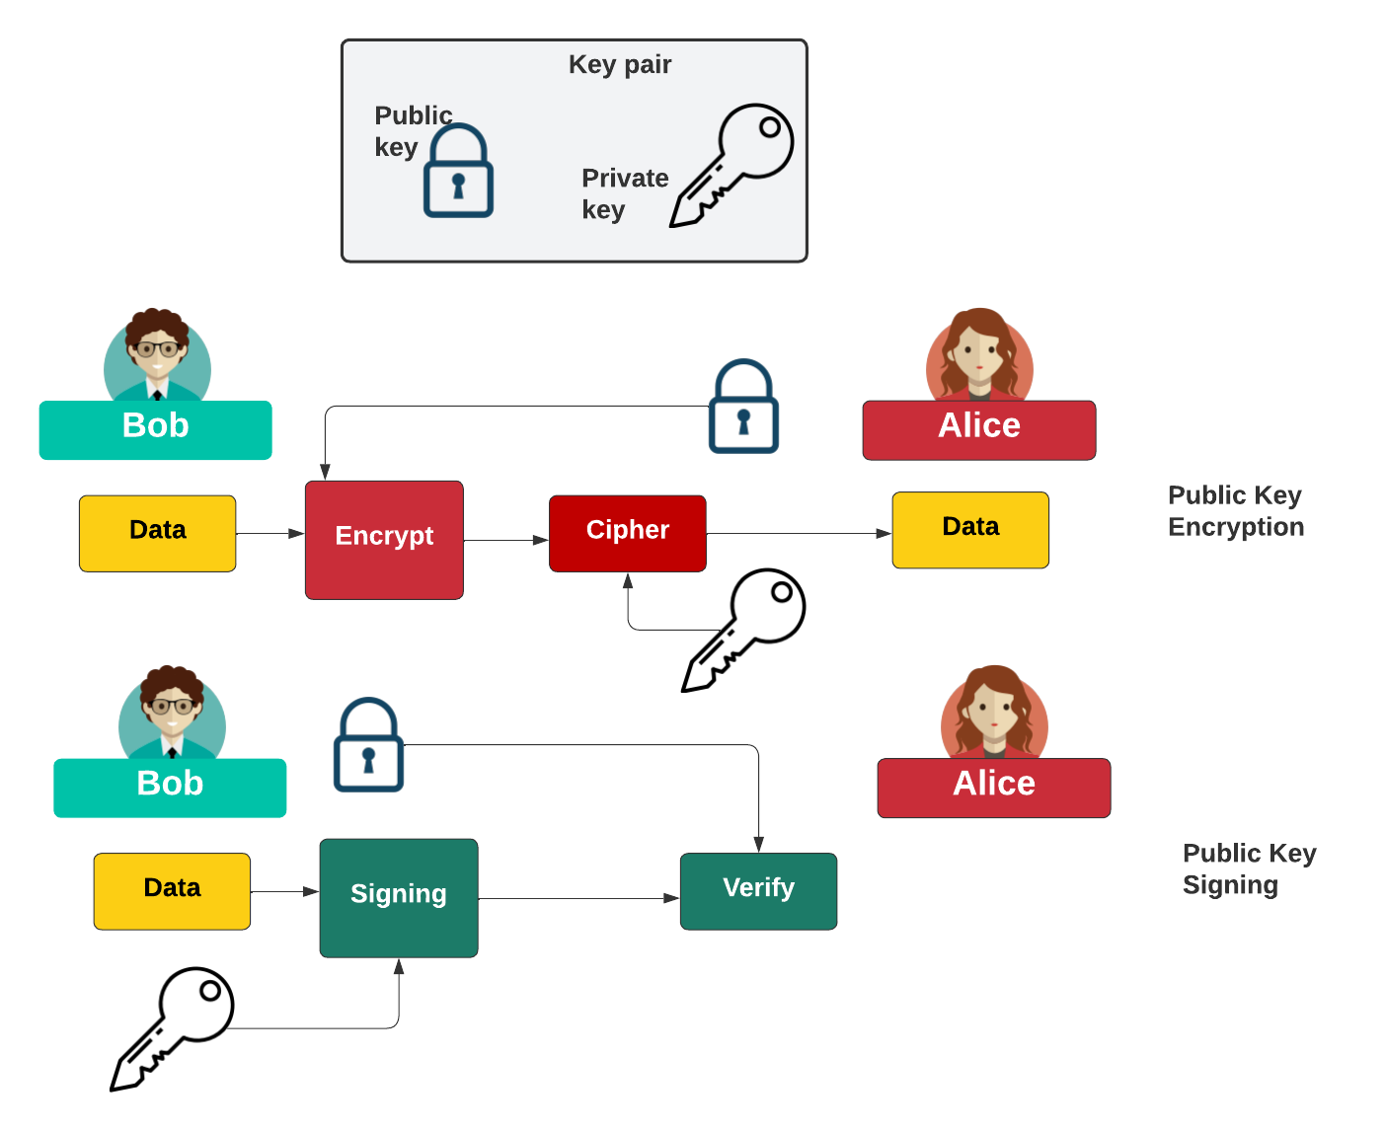
Public Key

Slide 12
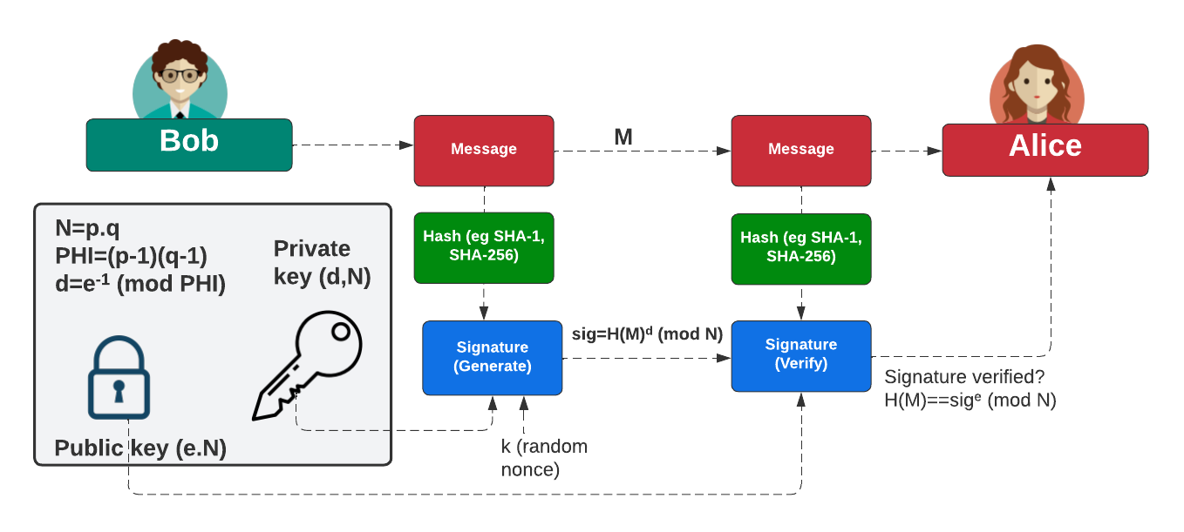
Digital Signatures

Slide 13
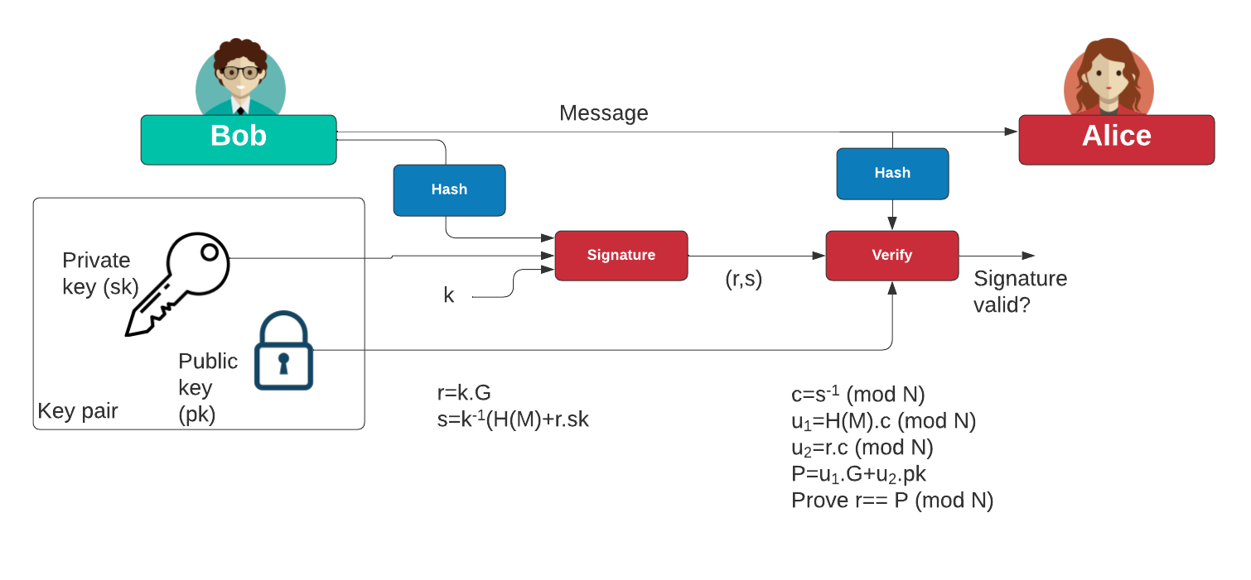
ECDSA
https://asecuritysite.com/ecdsa/ecdsa3

Slide 14
Zero Knowledge Proofs
Prof Bill Buchanan OBE FRSE
https://asecuritysite.com/zero
https://asecuritysite.com/dleq

Slide 15
Zero-knowledge Proof
Peggy is the prover.
Victor is the verifier.
Ali Baba - poor woodcutter - discovers the secret of a thieves as “open sesame”

Slide 16
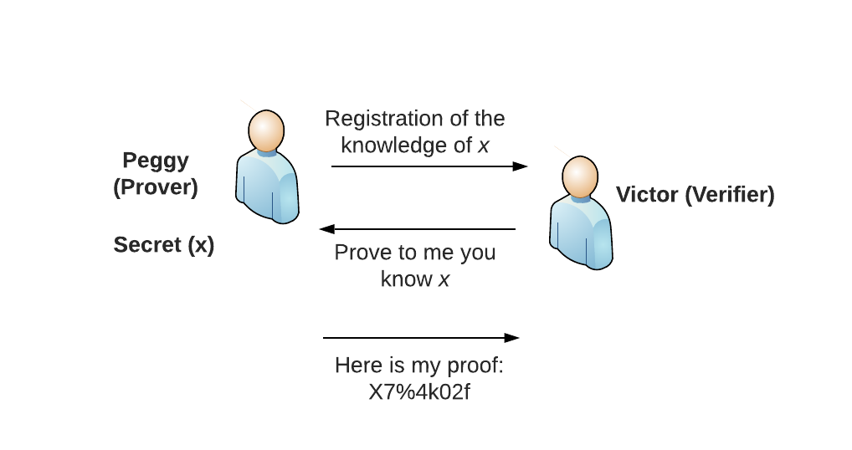
Interactive Zero-Knowledge Proof

Slide 17

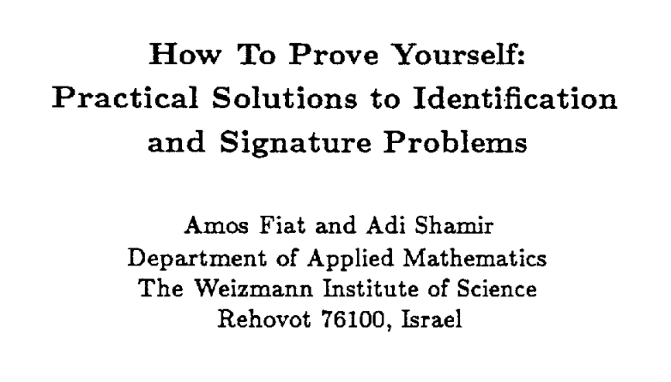

Zero Knowledge Proof

Slide 18
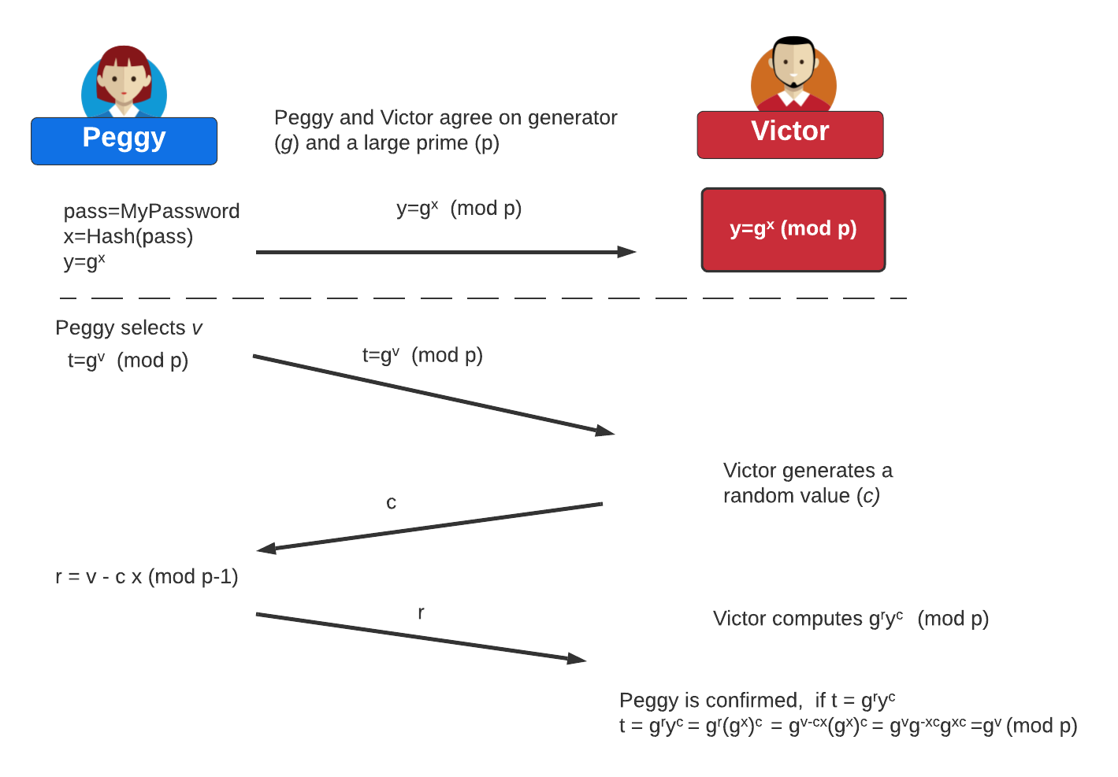
Interactive random oracle access
g^{r} y^{c} = g^{v- cx} (g^{x})^{c}
= g^{v- cx} g^{xc}
= g^{v- cx+ cx}
= g^{v}

Slide 19
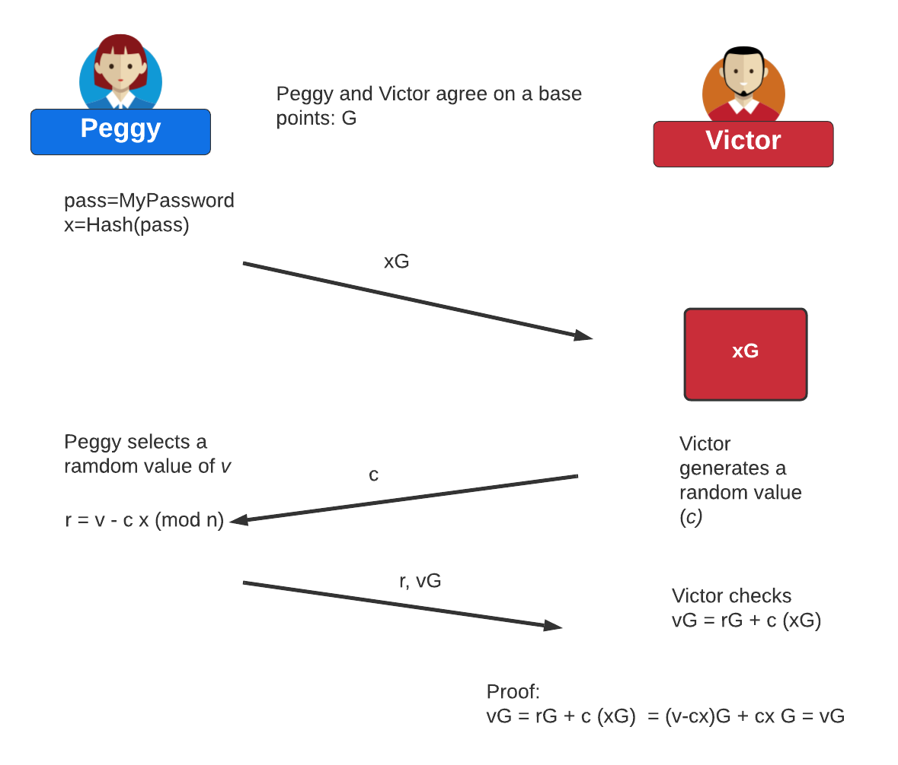
Zero-knowledge Proof (Interactive – Discrete Logs to ECC)

Slide 20
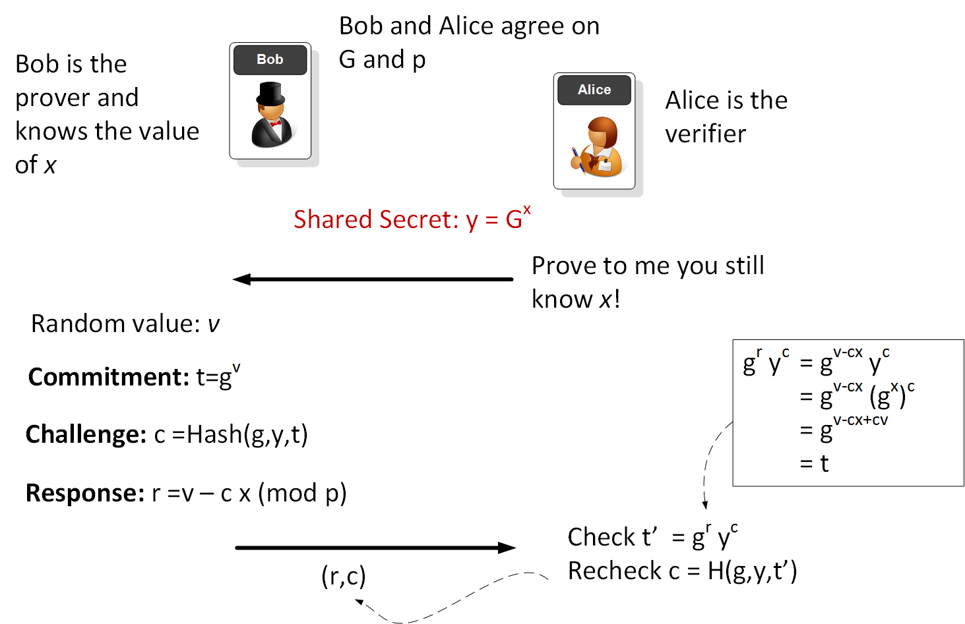
Non-interactive random oracle access Zero Knowledge Proof (Discrete Logs)

Slide 21
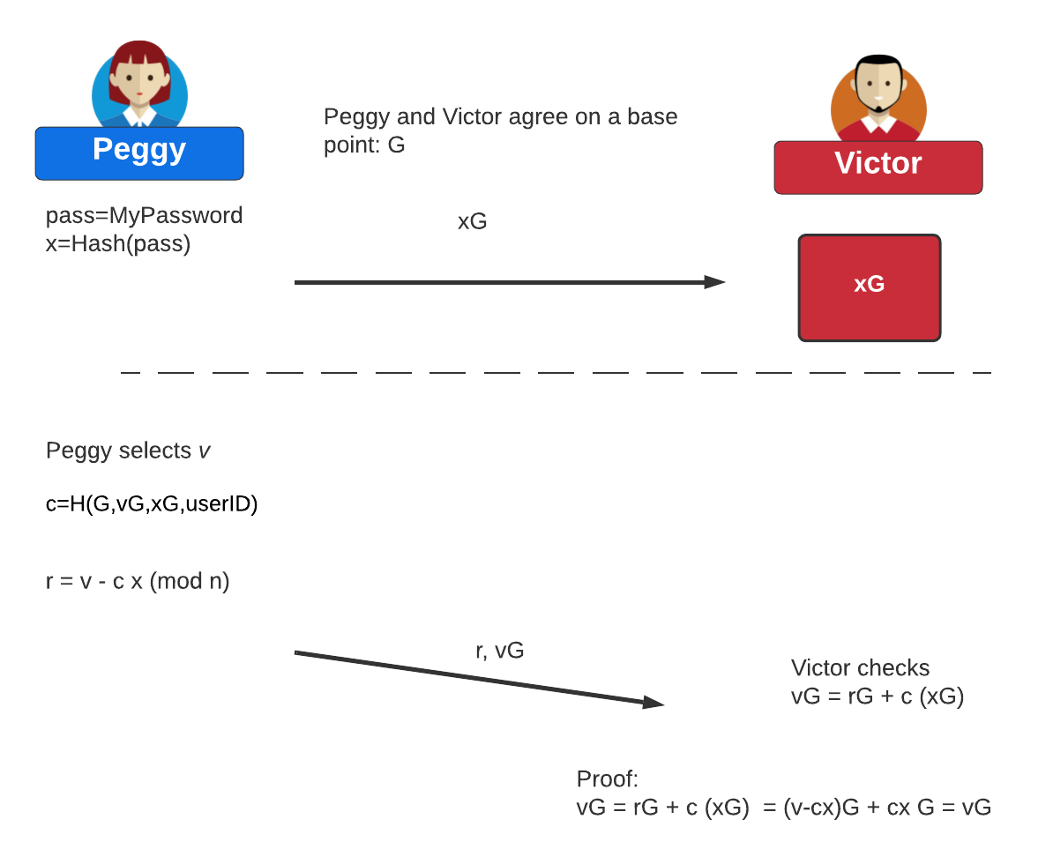
Non-interactive random oracle access Zero Knowledge Proof (ECC)

Slide 22
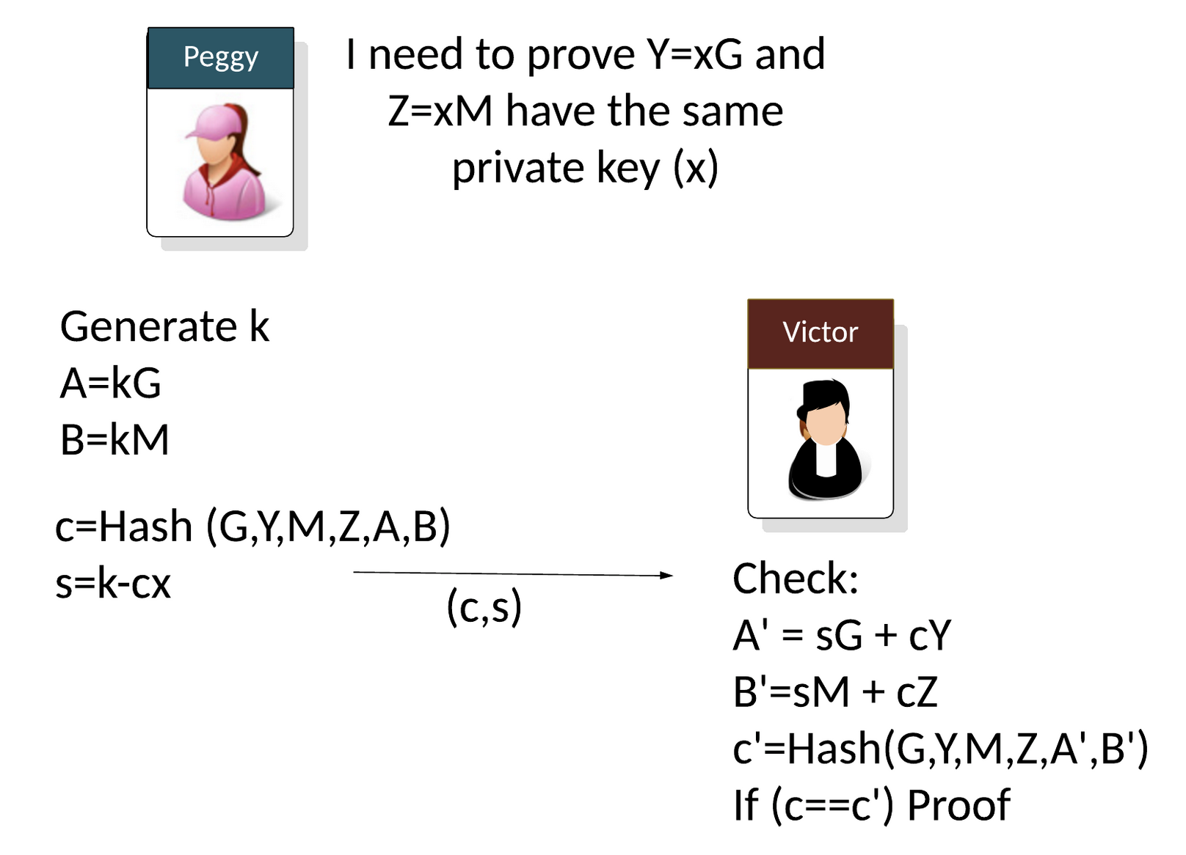
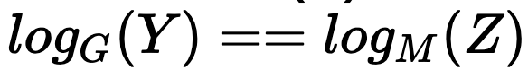
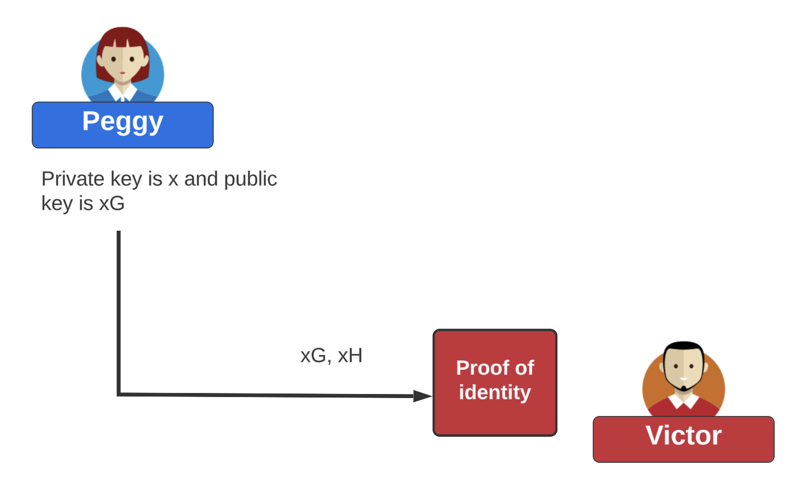
NIZK (Non-interactive Zero Knowledge) proofs of discrete - log equality

Slide 23
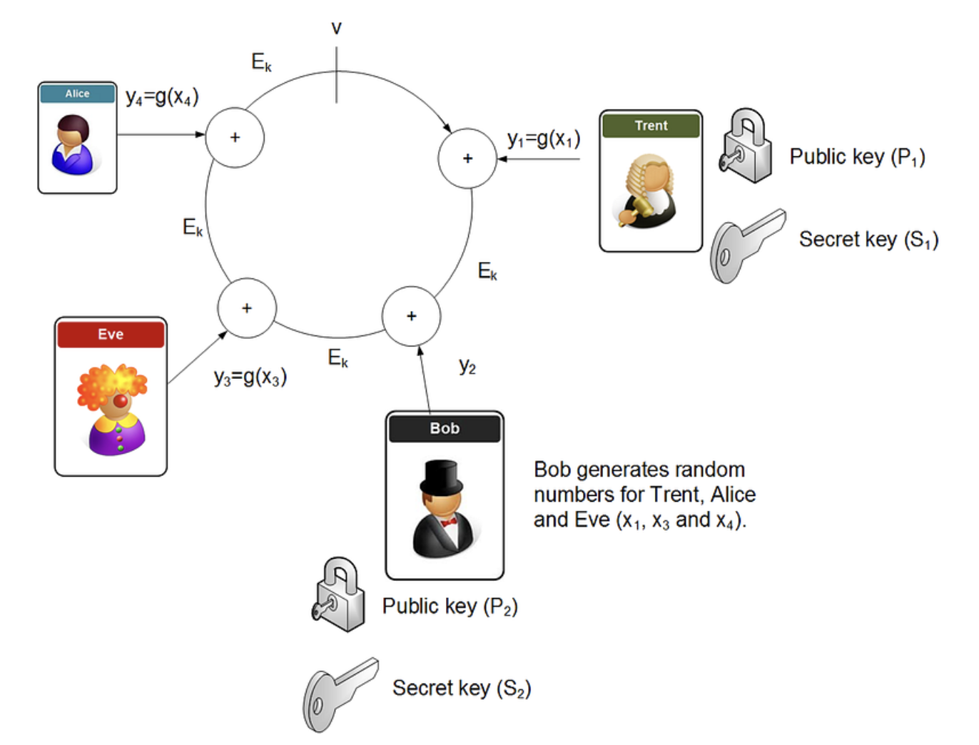
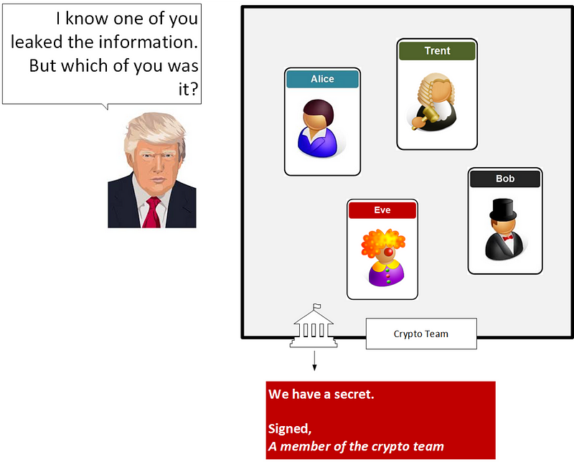
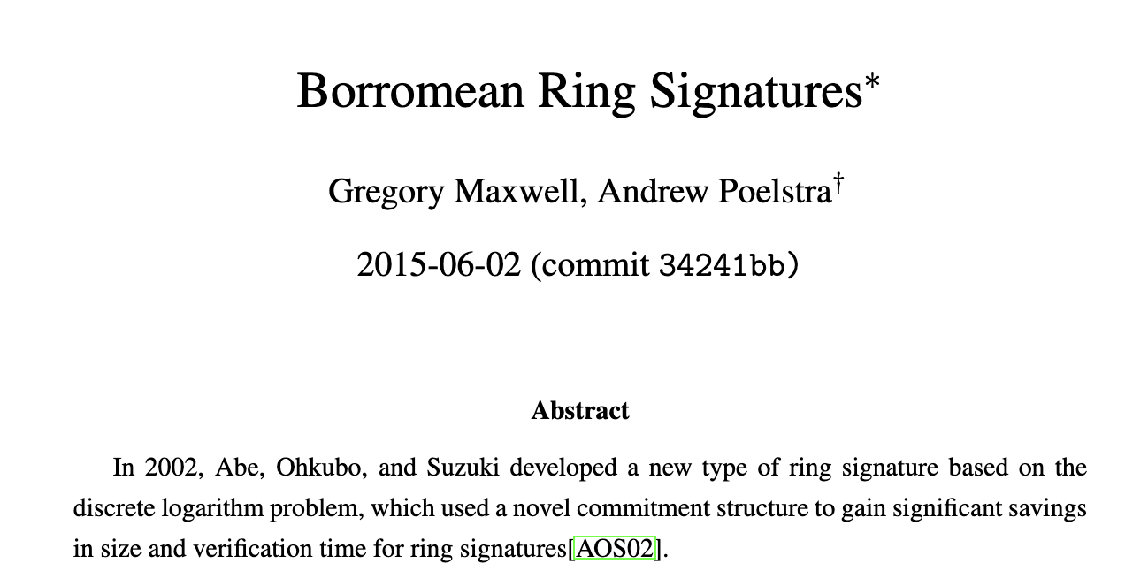
Ring Signatures
Ring signature, and which provides anonymity, unforgivably and collusion resistance.

Slide 24
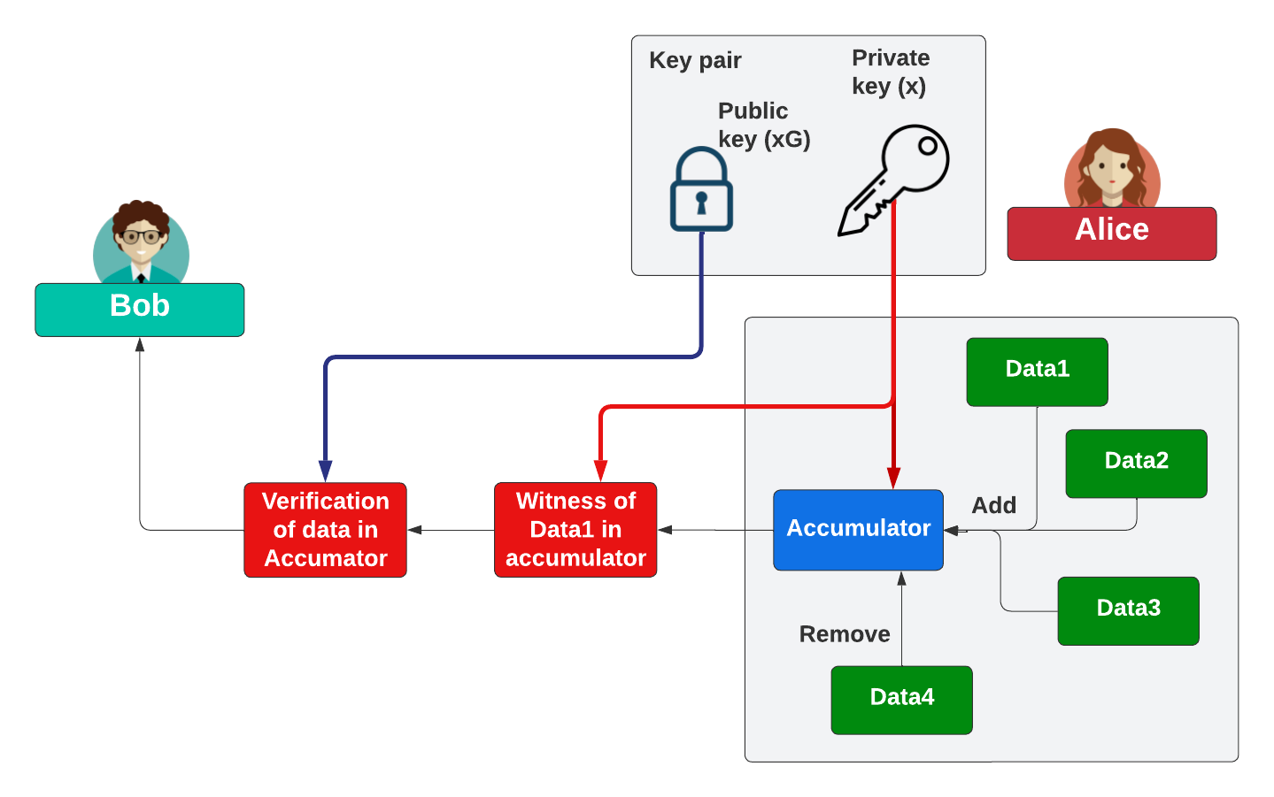
Accumulators

Slide 25
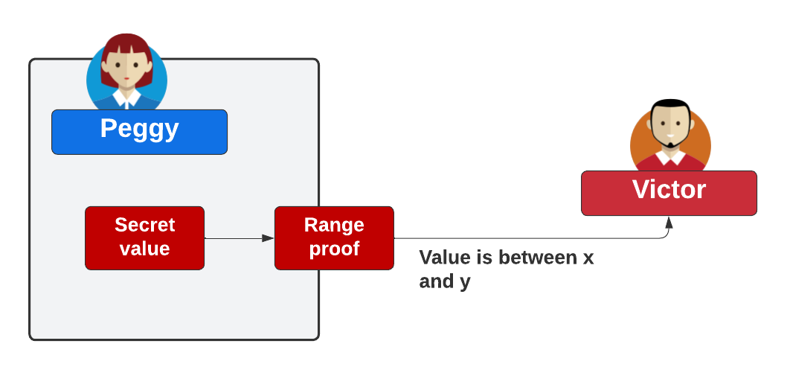
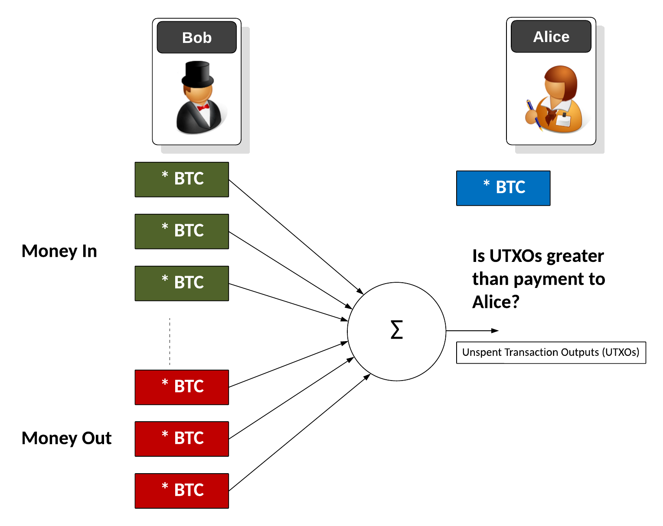
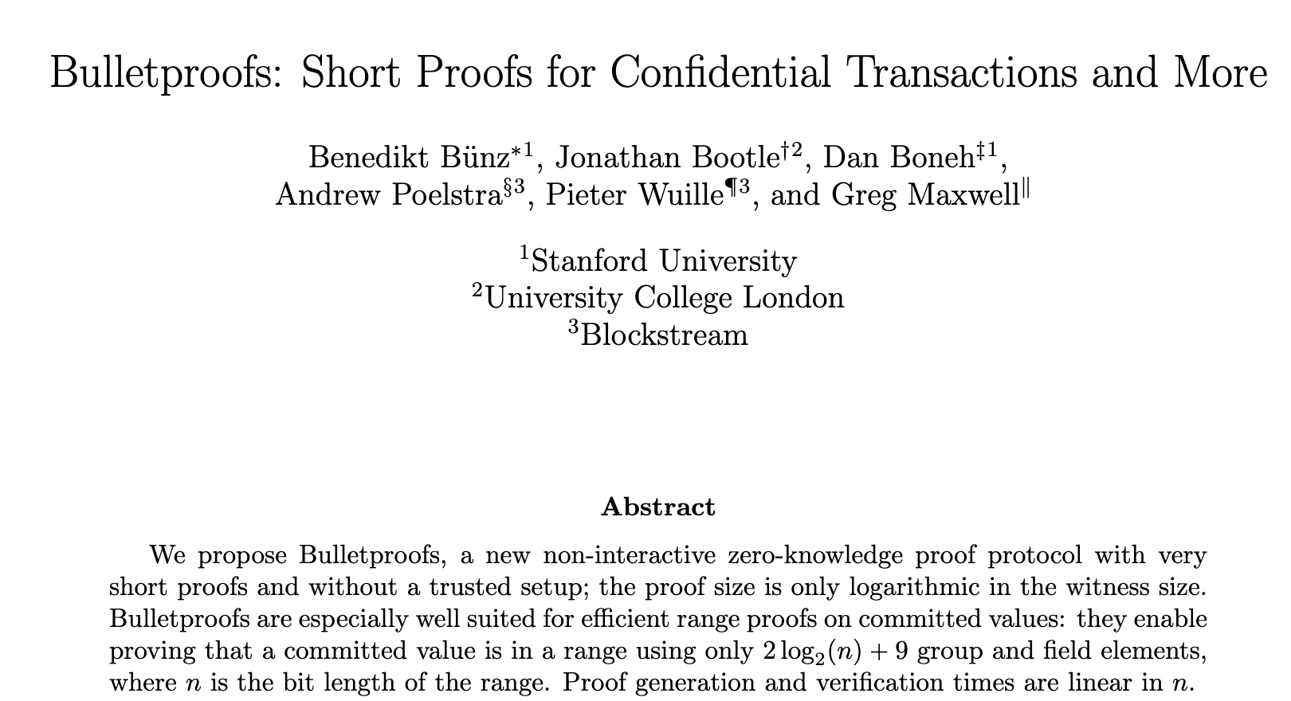
Range Proofs – such as Bulletproofs

Slide 26
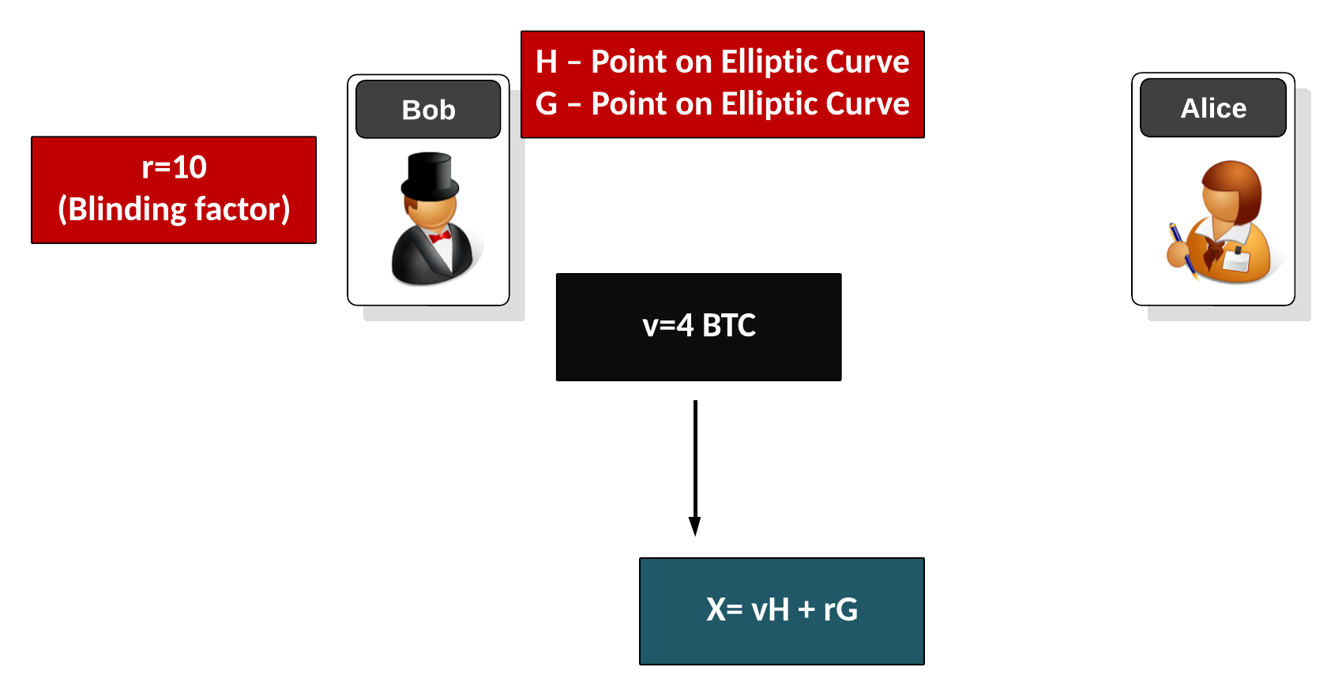
Pedersen Commitment

Slide 27
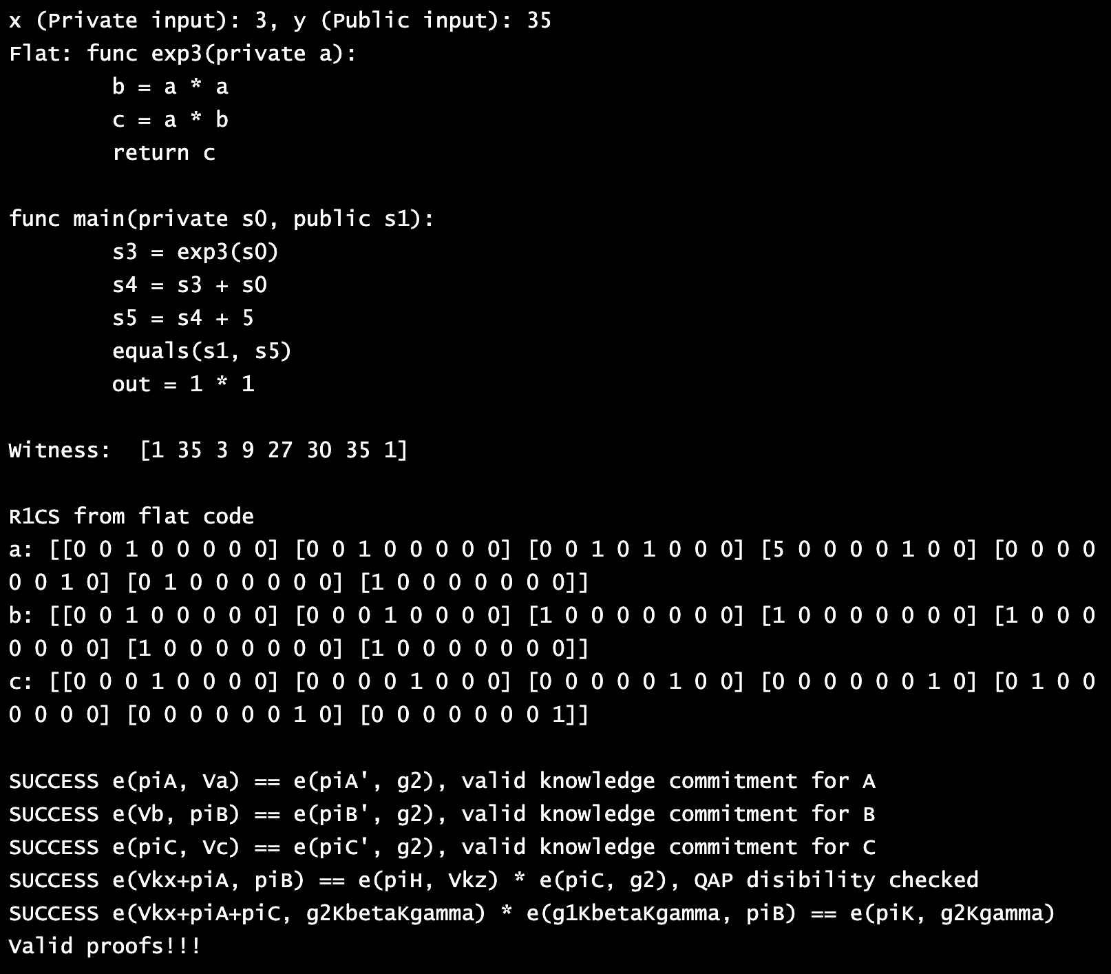
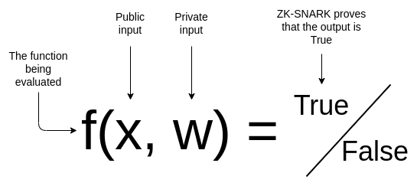
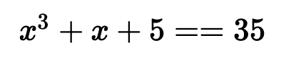
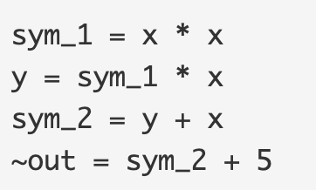
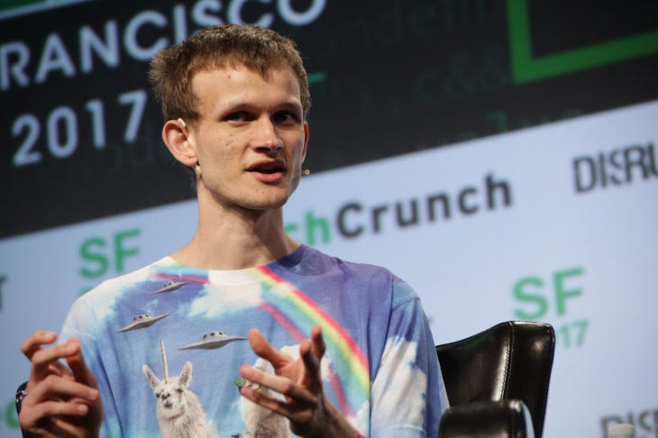
zkSnarks (Zero-Knowledge Succinct Non-Interactive Argument of Knowledge)– with R1CS (Rank 1 Constraint System)

Slide 28
Fully Homomorphic Encryption (FHE)
Prof Bill Buchanan OBE FRSE
https://asecuritysite.com/openfhe

Slide 29
FHE: Background
Prof Bill Buchanan OBE, Blockpass ID Lab
http://asecuritysite.com

Slide 30
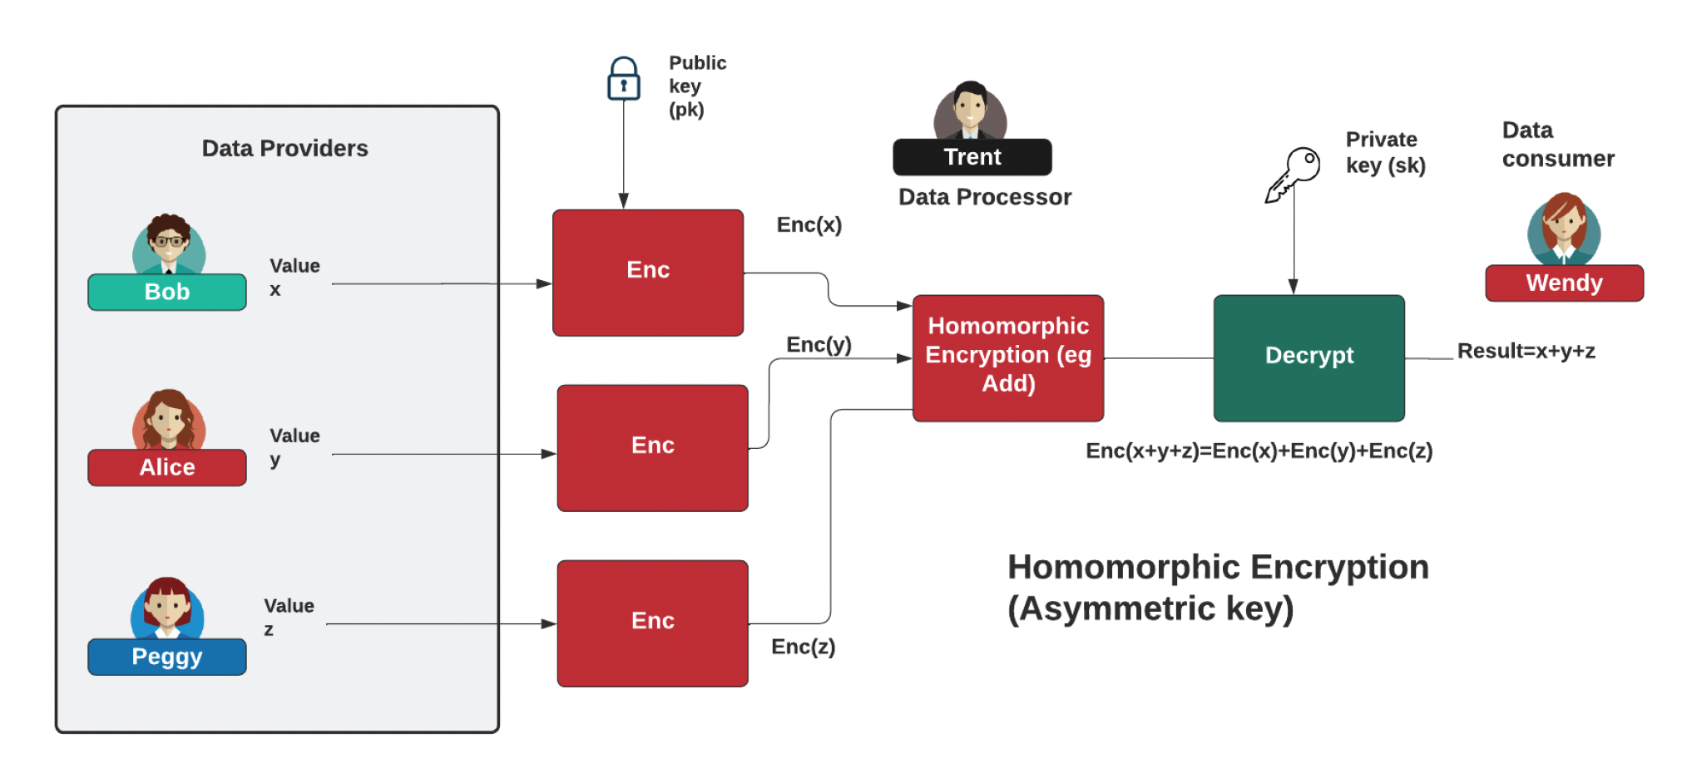
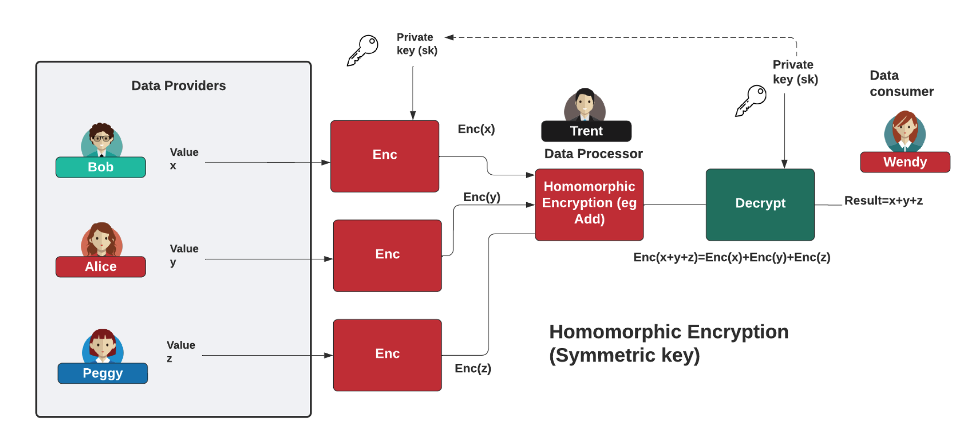
FHE

Slide 31
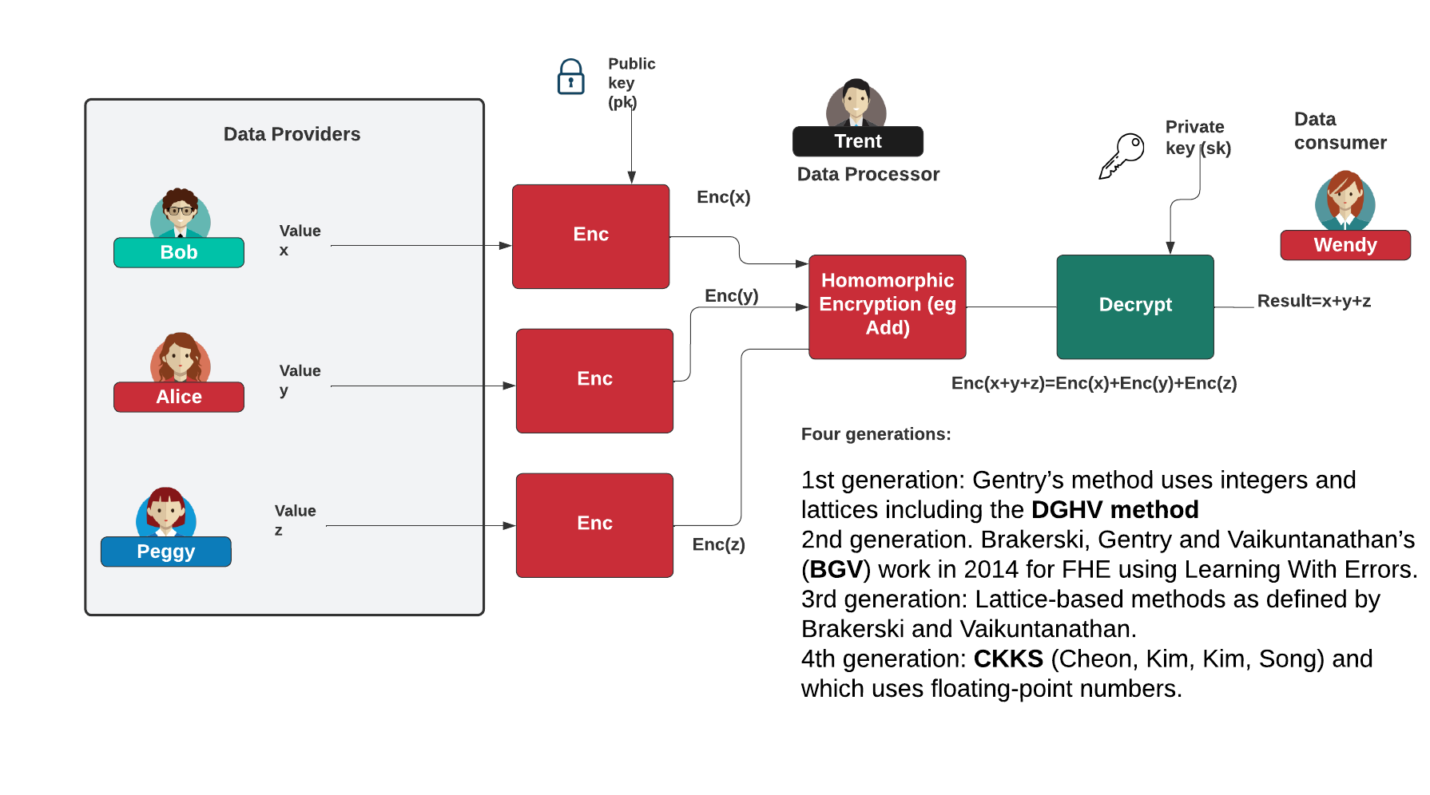

Homomorphic Encryption
https://asecuritysite.com/homomorphic/

Slide 32
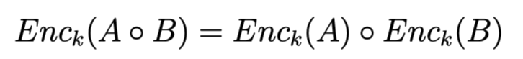
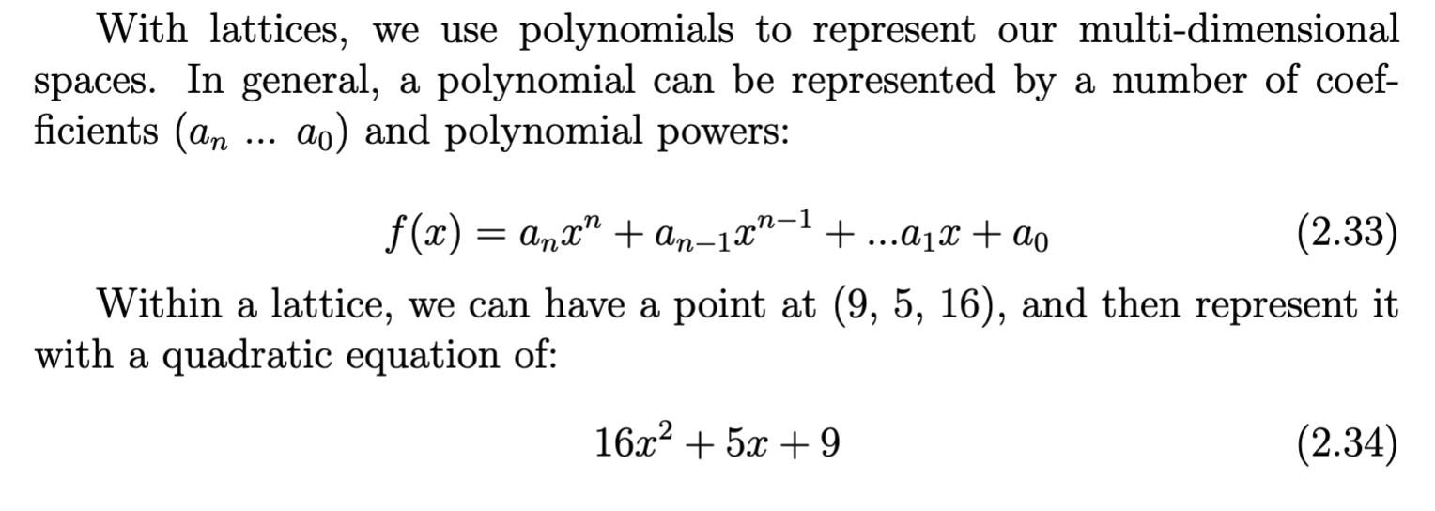
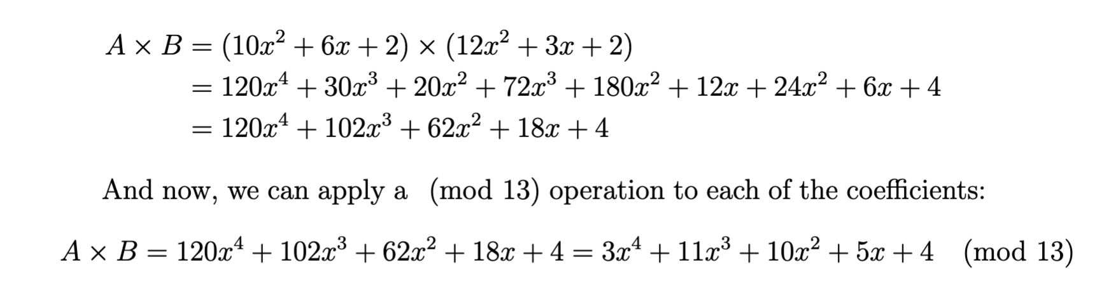
Polynomials

Slide 33
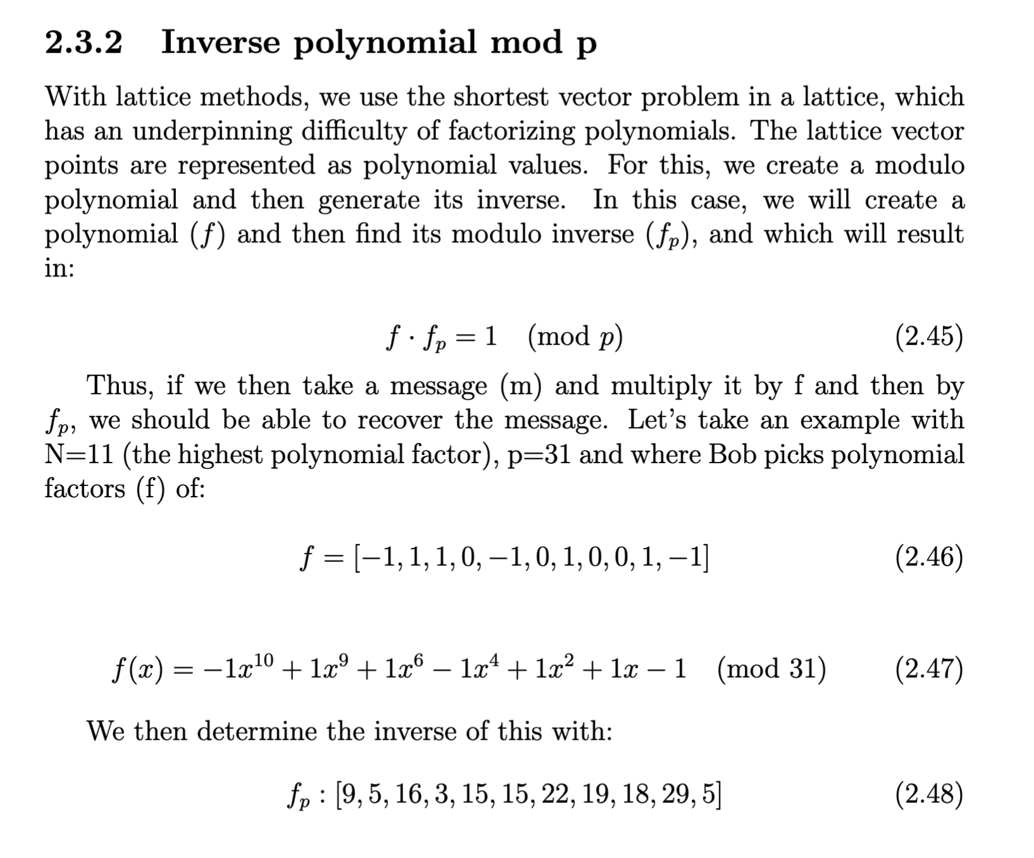
Inv Mod p

Slide 34
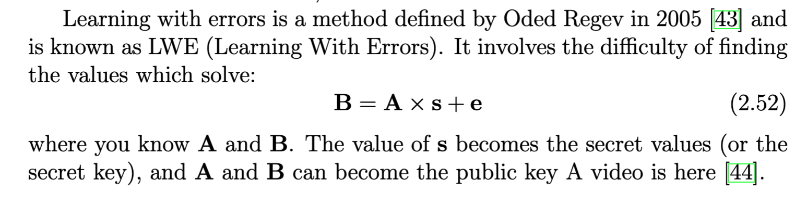
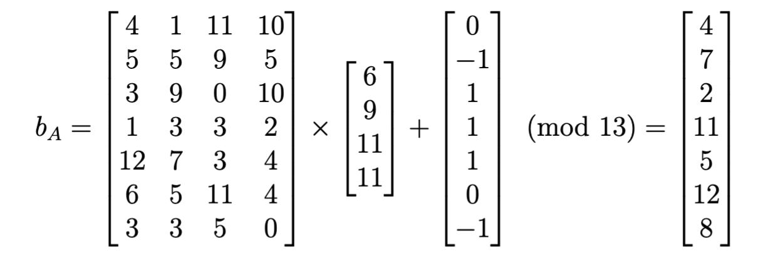
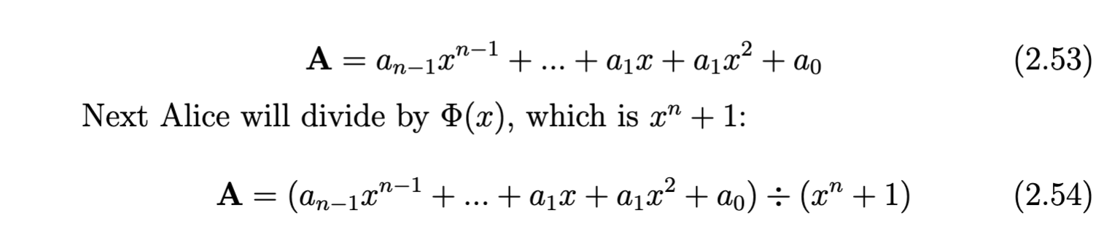
RLWE

Slide 35
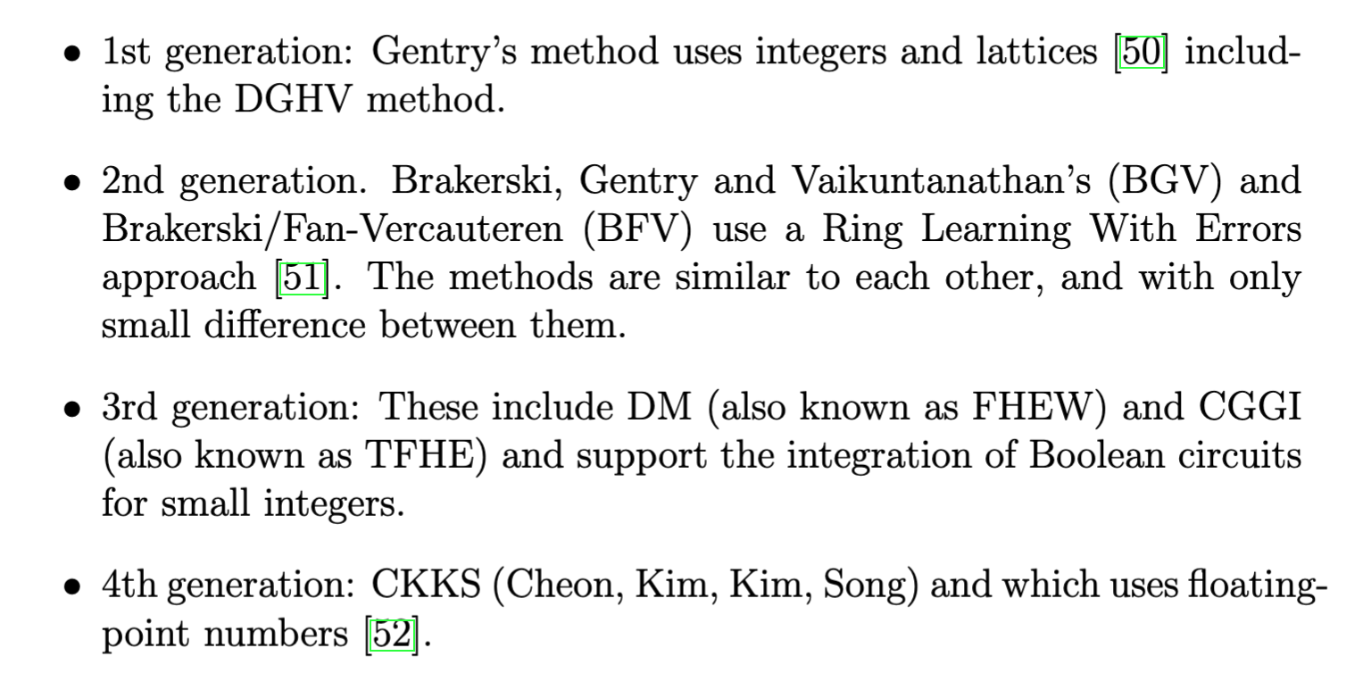
FHE

Slide 36
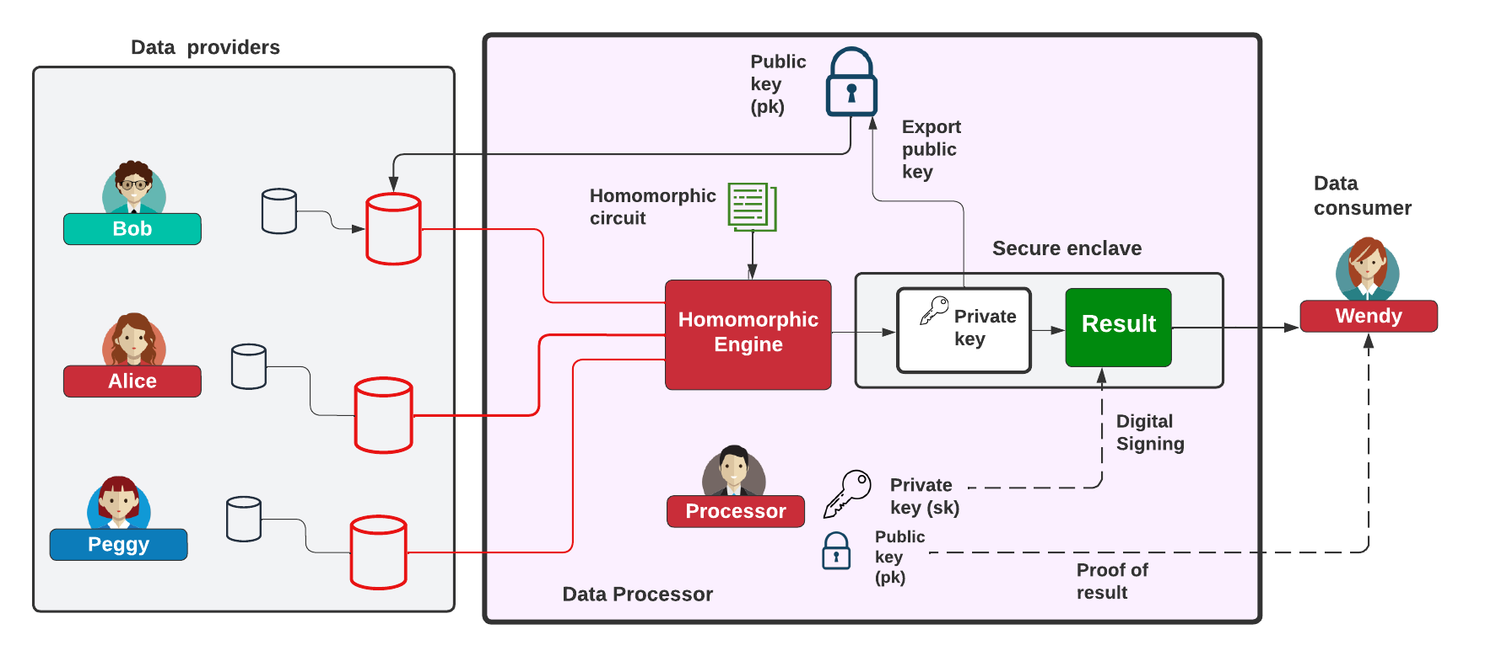
Homomorphic Processing

Slide 37
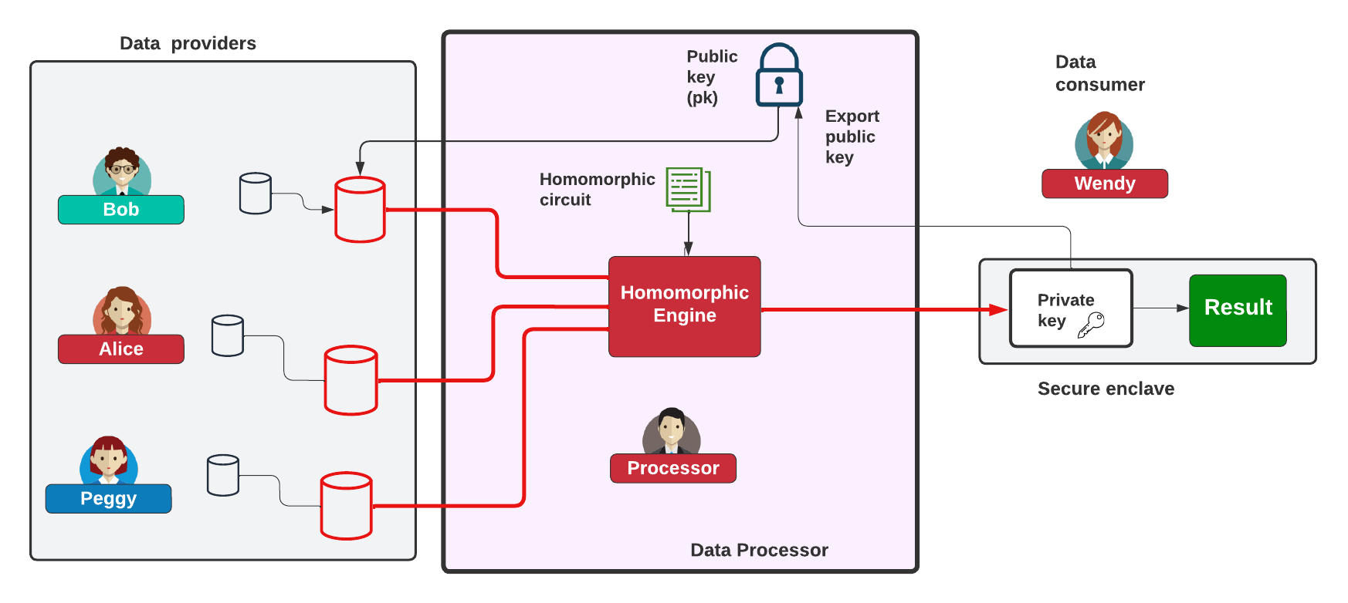
Homomorphic Processing

Slide 38
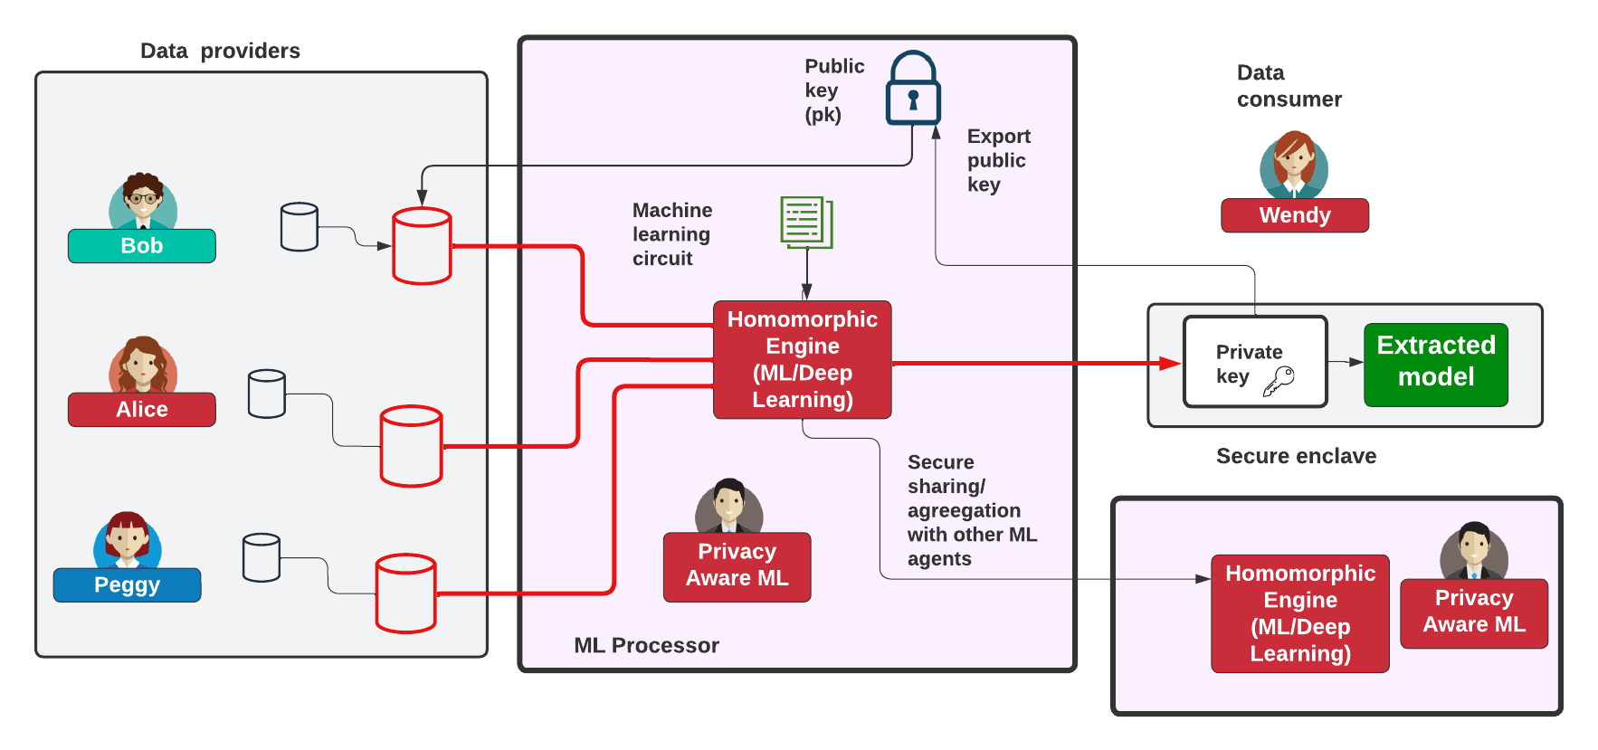
Homomorphic ML

Slide 39
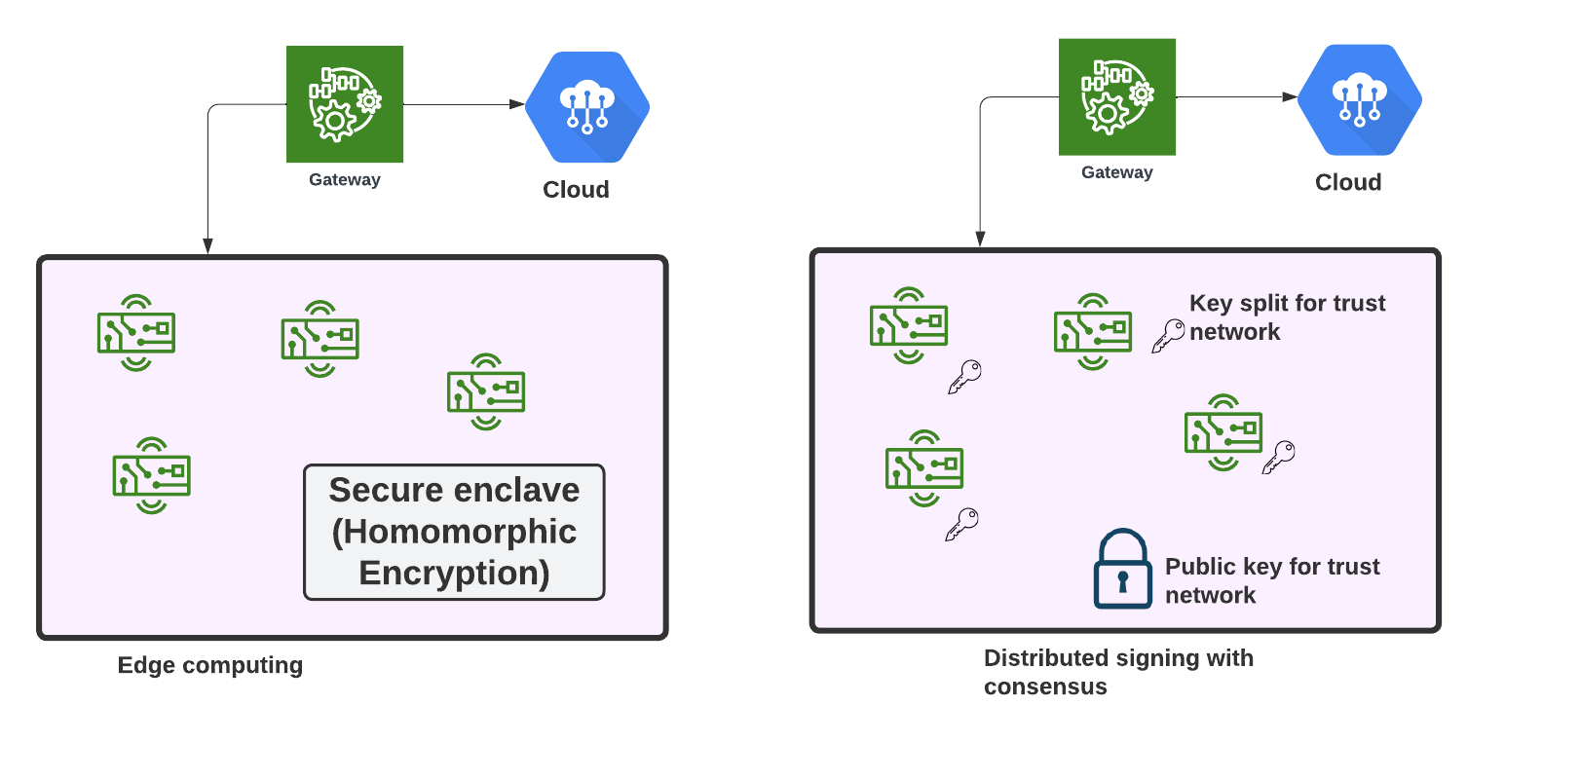
Edge Computing/Trusted Environment

Slide 40
FHE: Concepts and Code
Prof Bill Buchanan OBE, Blockpass ID Lab
http://asecuritysite.com

Slide 41
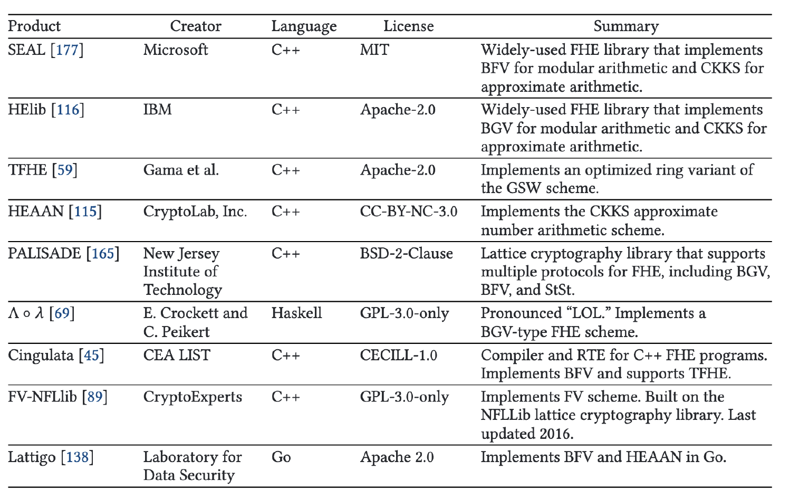
Libraries
OpenFHE

Slide 42
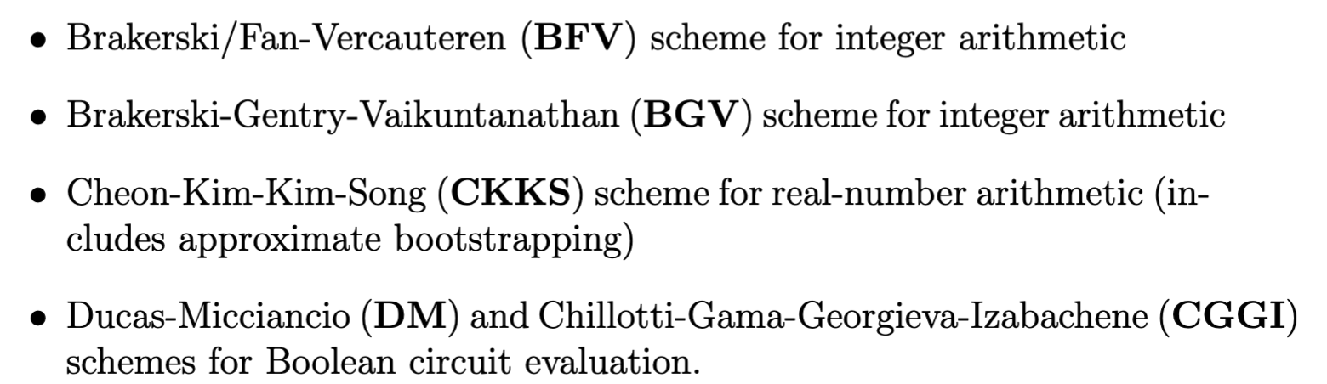
OpenFHE

Slide 43


Bootstrapping

Slide 44


Bootstrapping and Slots
Each ciphertext can have an associated "level" and a value of "noise".
We have various levels. One multiplication consumes a level, and adds noise.
When we reach zero or the noise level is too high, we need to bootstrap - raises the level and reduce noise.

Slide 45


SEAL BFV/BGV
PolyModulusDegree: Defines number of coefficients in plaintext polynomials and the size of ciphertext elements. Must be a power of 2 (such as 1024, 2048, 4096, 8192, 16384, or 32768). Affects performance)
PlainModulus: Largest coefficient that plaintext polynomials can represent. Affects performance.
Add
Plaintext
Plaintext
Square
Encryptor
Evaluator
Decryptor
Ciphertext
Ciphertext

Slide 46

SEAL CKKS
PolyModulusDegree: Defines number of coefficients in plaintext polynomials and the size of ciphertext elements. Must be a power of 2 (such as 1024, 2048, 4096, 8192, 16384, or 32768). Affects performance)
Add
Plaintext
Plaintext
Square
Encryptor
Evaluator
Decryptor
Ciphertext
Ciphertext

Slide 47

CryptoContext and Parameters (BFV)
Plaintext Modulus
Multiplicative Depth
PKE Scheme Features
Generate key pair (sk, pk)
https://asecuritysite.com/openfhe/openfhe_00cpp

Slide 48


CryptoContext and Parameters (CKKS)
Multiplication depth
Scale Mod Size
https://asecuritysite.com/openfhe/openfhe_00cpp_ckks

Slide 49


BFV - Adding/Multiplying Two Numbers
https://asecuritysite.com/openfhe/openfhe_02cpp

Slide 50



CCKS - Adding/Multiplying Two Numbers
https://asecuritysite.com/openfhe/openfhe_05cpp

Slide 51


BFV - Batch Processing
https://asecuritysite.com/openfhe/openfhe_08cpp

Slide 52







MD/FHEW
https://asecuritysite.com/openfhe/openfhe_09cpp
https://asecuritysite.com/openfhe/openfhe_09cpp_pke

Slide 53





MD/FHEW
https://asecuritysite.com/openfhe/openfhe_11cpp
https://asecuritysite.com/openfhe/openfhe_11cpp_pke

Slide 54






MD/FHEW - MUX and Majority
https://asecuritysite.com/openfhe/openfhe_11cpp
https://asecuritysite.com/openfhe/openfhe_11cpp_pke

Slide 55



Chebyshev Functions
With approximation theory, it is possible to determine an approximate polynomial p(x)
that is approximate to a function f(x).
https://asecuritysite.com/openfhe/openfhe_18cpp

Slide 56



Polynomial Evaluation
https://asecuritysite.com/openfhe/openfhe_20cpp

Slide 57
FHE: Data Sharing
Prof Bill Buchanan OBE, Blockpass ID Lab
http://asecuritysite.com

Slide 58

Homomorphic Sharing

Slide 59

Multiparty Sharing

Slide 60

SmartCrypt

Slide 61

Using Symmetric Key for HE

Slide 62




Proxy Re-encryption (PRE)
https://asecuritysite.com/openfhe/openfhe_21cpp

Slide 63
FHE in the Cloud
Prof Bill Buchanan OBE, Blockpass ID Lab
http://asecuritysite.com

Slide 64


Symmetric/Asymmetric in Cloud

Slide 65


Searchable Encryption

Slide 66



Location Tracking

Slide 67

Privacy-aware biometrics/ID

Slide 68


Apple Privacy Aware

Slide 69
FHE: MPC
Prof Bill Buchanan OBE, Blockpass ID Lab
http://asecuritysite.com

Slide 70




Threshold Encryption
https://asecuritysite.com/openfhe/openfhe_16cpp
https://asecuritysite.com/openfhe/openfhe_17cpp

Slide 71
FHE: ML
Prof Bill Buchanan OBE, Blockpass ID Lab
http://asecuritysite.com

Slide 72



Matrix Operations

Slide 73

Private Prediction as a Service
[87] M. Iezzi, “Practical privacy-preserving data science with homomorphic encryption: an overview,” in 2020 IEEE International Conference on Big Data (Big Data). IEEE, 2020, pp. 3979–3988.

Slide 74





Logistic Function
https://asecuritysite.com/openfhe/openfhe_19cpp

Slide 75



Matrix Operations
https://asecuritysite.com/openfhe/openfhe_13cpp
https://asecuritysite.com/openfhe/openfhe_14cpp

Slide 76



Matrix Operations
https://asecuritysite.com/openfhe/openfhe_27cpp

Slide 77




Matrix Operations
https://asecuritysite.com/openfhe/openfhe_27cpp
https://asecuritysite.com/openfhe/openfhe_26cpp

Slide 78


Matrix Operations
https://asecuritysite.com/openfhe/openfhe_27cpp
https://asecuritysite.com/openfhe/openfhe_26cpp

Slide 79



Matrix Operations
https://asecuritysite.com/openfhe/openfhe_28cpp
https://asecuritysite.com/openfhe/openfhe_29cpp

Slide 80


GWAS (Gnome-wide Association Studies)

Slide 81

SVM

Slide 82


Concrete-ML

Slide 83
Future of Digital Trust
Prof Bill Buchanan OBE FRSE
https://asecuritysite.com
Zero Knowledge Proofs Fiat Shamir, DLEQ, zkSnarks,
Ring Signatures, Range Proofs, Accumulators, Pedersen Commitments
Homomorphic Encryption:
Basics
Concepts and Code Data Sharing Cloud Processing MPC Machine Learning

